Slide 1
Chapter 1 Data and Statistics
Modified by L. NAJJAR(UNO-ISQA)

Slide 2
1.2 Data
Data are the facts and figures that are collected, summarized, analyzed, and interpreted.
The data collected in a particular study are referred to as the data set.

Slide 3
Elements, Variables, and Observations
The elements are the entities on which data are collected.
A variable is a characteristic of interest for the elements.
The set of measurements collected for a particular element is called an observation.
The total number of data values in a data set is the number of elements multiplied by the number of variables.

Slide 4
Data, Data Sets, Elements, Variables, and Observations
Stock Annual Earn/
Company Exchange Sales($M) Sh.($)
Dataram AMEX 73.10 0.86
EnergySouth OTC 74.00 1.67
Keystone NYSE 365.70 0.86
LandCare NYSE 111.40 0.33
Psychemedics AMEX 17.60 0.13
Observation
Variables
Elements
Data Set
Datum

Slide 5
Scales of Measurement
Scales of measurement include:
Nominal
Interval
Ordinal
Ratio
The scale determines the amount of information
contained in the data.
The scale indicates the data summarization and
statistical analyses that are most appropriate.

Slide 6
Scales of Measurement (cont.)
Nominal
Data are labels or names used to identify an
attribute of the element.
A nonnumeric label or numeric code may be used.

Slide 7
Scales of Measurement (cont.)
Nominal
Example:
Students of a university are classified by the
school in which they are enrolled using a
nonnumeric label such as Business, Humanities,
Education, and so on.
Alternatively, a numeric code could be used for
the school variable (e.g. 1 denotes Business,
2 denotes Humanities, 3 denotes Education, and
so on).

Slide 8
Scales of Measurement (cont.)
Ordinal
The data have the properties of nominal data and
the order or rank of the data is meaningful.
A nonnumeric label or numeric code may be used.

Slide 9
Scales of Measurement (cont.)
Ordinal
Example:
Students of a university are classified by their
class standing using a nonnumeric label such as
Freshman, Sophomore, Junior, or Senior.
Alternatively, a numeric code could be used for
the class standing variable (e.g. 1 denotes
Freshman, 2 denotes Sophomore, and so on).

Slide 10
Scales of Measurement (cont.)
Interval
The data have the properties of ordinal data, and
the interval between observations is expressed in
terms of a fixed unit of measure.
Interval data are always numeric.
Example:
Melissa has an SAT score of 1205, while Kevin
has an SAT score of 1090. Melissa scored 115
points more than Kevin.

Slide 11
Scales of Measurement (cont.)
Ratio
The data have all the properties of interval data
and the ratio of two values is meaningful.
Variables such as distance, height, weight, and time
use the ratio scale.
This scale must contain a zero value that indicates
that nothing exists for the variable at the zero point.

Slide 12
Scales of Measurement (cont.)
Ratio
Example:
Melissa’s college record shows 36 credit hours
earned, while Kevin’s record shows 72 credit
hours earned. Kevin has twice as many credit
hours earned as Melissa.

Slide 13
Qualitative and Quantitative Data
Data can be further classified as being qualitative
or quantitative.
The statistical analysis that is appropriate depends
on whether the data for the variable are qualitative
or quantitative.
In general, there are more alternatives for statistical
analysis when the data are quantitative.

Slide 14
Qualitative Data
Labels or names used to identify an attribute of each
element
Often referred to as categorical data
Use either the nominal or ordinal scale of
measurement
Can be either numeric or nonnumeric
Appropriate statistical analyses are rather limited

Slide 15
Quantitative Data
Quantitative data indicate how many or how much:
discrete, if measuring how many
continuous, if measuring how much
Quantitative data are always numeric.
Ordinary arithmetic operations are meaningful for
quantitative data.

Slide 16
Scales of Measurement
Data
Qualitative
Quantitative
Numerical
Nonnumerical
Numerical
Nominal
Ordinal
Nominal
Ordinal
Interval
Ratio

Slide 17
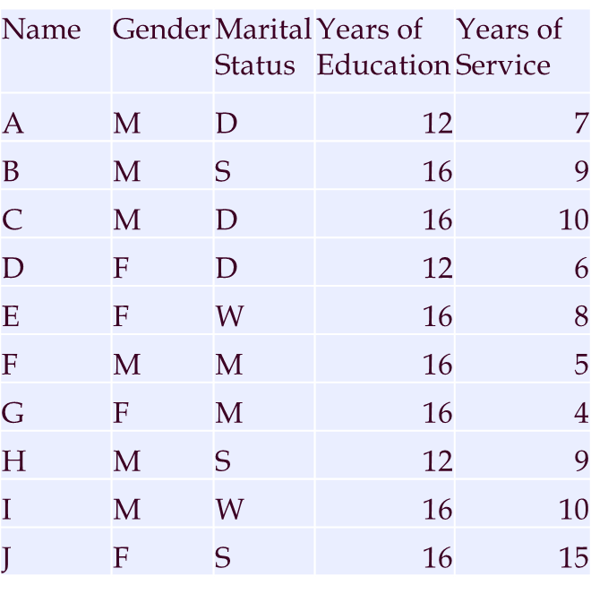
Example 1

Slide 18
Cross-Sectional and Time Series Data
Cross-sectional data are collected at the same or approximately the same point in time.
Example: data detailing the number of building permits issued in June 2000 in each of the counties of Texas
Time series data are collected over several time periods.
Example: data detailing the number of building permits issued in Travis County, Texas in each of the last 36 months

Slide 19
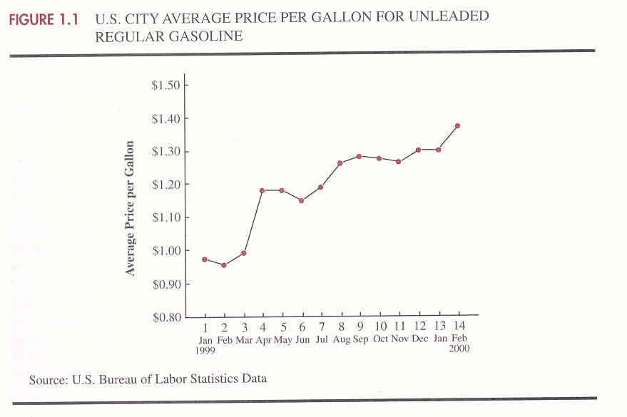
Cross-Sectional and Time Series Data(cont.)

Slide 20
1.4 Descriptive Statistics
Descriptive statistics are the tabular, graphical, and numerical methods used to summarize data.

Slide 21
Example 1 : Hudson Auto Repair
The manager of Hudson Auto would like to have
a better understanding of the cost of parts used in the
engine tune-ups performed in the shop. She examines
50 customer invoices for tune-ups. The costs of parts,
rounded to the nearest dollar, are listed below.

Slide 22
Example 1: Hudson Auto Repair(cont.)
Tabular Summary (Frequencies and Percent Frequencies
Parts Percent
Cost ($) Frequency Frequency
50-59 2 4
60-69 13 26
70-79 16 32
80-89 7 14
90-99 7 14
100-109 5 10
Total 50 100

Slide 23
Example 1 : Hudson Auto Repair(cont.)
Graphical Summary (Histogram)
18
16
14
12
Frequency
10
8
6
4
2
Parts
Cost ($)
50 60 70 80 90 100 110

Slide 24
Example 1 : Hudson Auto Repair(cont.)
Numerical Descriptive Statistics
The most common numerical descriptive statistic is the average (or mean).
Hudson’s average cost of parts, based on the 50 tune-ups studied, is $79 (found by summing the 50 cost values and then dividing by 50).

Slide 25
1.5 Statistical Inference
Statistical inference is the process of using data obtained from a small group of elements (the sample) to make estimates and test hypotheses about the characteristics of a larger group of elements (the population).
Population: The set of all elements of interest in a particular study.
Sample: A subset of the population.

Slide 26
Example 1 : Hudson Auto Repair
Process of Statistical Inference
1. Population
consists of all
tune-ups. Average
cost of parts is
unknown.
2. A sample of 50
engine tune-ups
is examined.
4. The value of the
sample average is used
to make an estimate of
the population average.
3. The sample data
provide a sample
average cost of
$79 per tune-up.

Slide 27
Example 2
Assume we are interested in the average age of UNO students.
Population of interest?
Size of the population?
Size of the sample?
Characteristics of interest?
Is the variable of interest QL or QN?
Descriptive statistic used in this study?
Describe the process of statistical inference in this study.

Slide 28
Chapter 3 Descriptive Statistics II: Numerical Methods
Measures of Location
Measures of Variability
Modified by L.Najjar
ISQA(UNO)
Notes:
Modified by L.Najjar
ISQA(UNO)

Slide 29
3.1 Measures of Location
Mean
Median
Mode
Percentiles
Quartiles
σ
μ
%
x

Slide 30
Mean
Mean: Is a measure of central location of data set.
66.67
Population Sample
20
80
100
N
n
Notes:
66.67

Slide 31
Mean(cont.)
The mean of a data set is the average of all the data values.
If the data are from a sample, the mean is denoted by
.
If the data are from a population, the mean is denoted by (mu).

Slide 32
Example 1
The price- earnings ratios for a sample of 10 common stocks are shown below. Find the mean.
Company | P/E
1 | 5
2 | 7
3 | 17
4 | 10
5 | 14
6 | 11
7 | 13
8 | 8
9 | 7
10 | 8
=5+……..+8/10=10

Slide 33
Median
The median of a data set is the value in the middle when the data items are arranged in ascending order.
50% median 50%
If there is an odd number of items, the median is the value of the middle item.
0 5 8 4 5 3 2
0 2 3 4 5 5 8
If there is an even number of items, the median is the average of the values for the middle two items.
0 2 3 4 5 5 8 9
Median=4+5/2=4.5

Slide 34
Median (cont.)
Remark: If there are extreme values. The median provides a better measure of central location than mean.
Ex. Consider the following incomes(in 1000) :
17, 18, 20, 22, 70
Find the mean and the median.Which one is a better measure of central location ?
= 17+……+70/5=29.4 (in 1000)
Median= 20 (in 1000)

Slide 35
Mode
The mode of a data set is the value that occurs with greatest frequency.
4, 3, 4, 4, 5, 2
Remark: The mode is an important measure of location for QL data.
Class Standing Fr
FR 25
SP 15
JR 5
SR 5
Bimodal: Data with 2 modes 5,5,5,6,7,8,9,9,9,10
Multimodal: Data with more than 2 modes.

Slide 36
Percentiles
The pth percentile of a data set is a value such that at least p percent of the items take on this value or less and at least (100-p) percent of the items take on this value or more.
80th percentile for exam was 75, means
80% of students got 75
Quartiles
Quartiles are specific percentiles
First Quartile = 25th Percentile=Q1
Second Quartile = 50th Percentile =Q2
Third Quartile = 75th Percentile=Q3

Slide 37
Quartiles
25%
25%
25%
25%
Q1 Q2 Q3
Notes:
Q1 Q2 Q3 25%

Slide 38
Percentiles (cont.)
Arrange the data in ascending order.
Compute index i, the position of the pth percentile.
i = (p/100)n
If i is not an integer, round up. The pth percentile is the value in the ith position.
If i is an integer, the pth percentile is the average of the values in positions i and i+1.
Ex. A test was given to a sample of 20 students in a beginning typing class. Their scores were :
84 ,59,82,78,74,96,44,76,85,66
74,91,62,54,72,65,84,41,76,70
Find Q1,Q2,Q3,63th, and 92th percentiles.

Slide 39
Percentiles (cont.)
4 1 4 Q1:
5 4 9 i= .25(20)=5, Q1=(62+65)/2=63.5
6 2 5 6 Q2:
7 0 2 4 4 6 6 8 i= .50(20)=10, Q2=(74+74)/2=74
8 2 4 4 5 Q3:
9 1 6 i= .75(20)=15, Q3=(82+84)/2=83
63th :
i= .63(20)=12.6, 63th =76
92th :
i= .92(20)=18.4, 92th =91

Slide 40
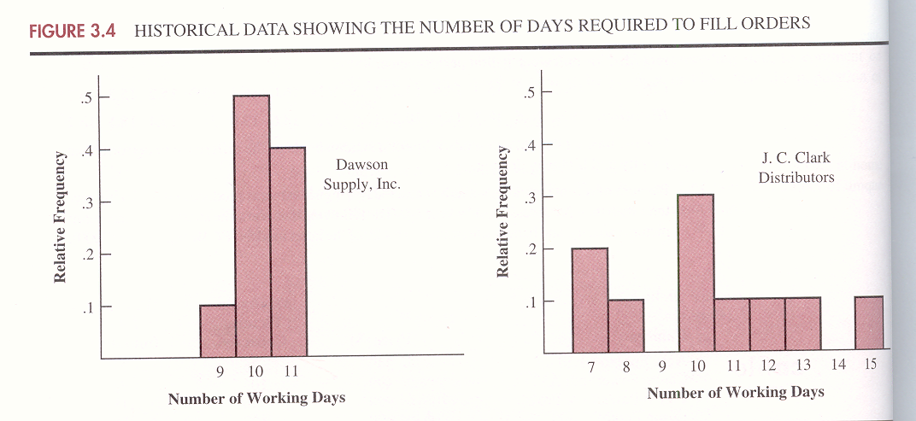
3.2 Measures of Variability
Variability(dispersion): Is the amount of variation or spread in the data

Slide 41
Measures of Variability(cont.)
Ex. Two patients in a hospital have their heart rates taken every 4 hours. Their heart rates over a 24- hours period were:
A: 68, 70, 69, 70, 71, 72 mean(A)=70
B: 65, 85, 90, 65, 55, 60 mean(B)=70
Use stem and leaf plot to see the amount of variability.
A: B:
6 8 9
7 0 0 1 2 5 5
6 0 5 5
7
8 5
9 0

Slide 42
Measures of Variability(cont.)
Range
Interquartile Range
Variance
Standard Deviation
Coefficient of Variation

Slide 43
Range
The range of a data set is the difference between the largest and smallest data values.
R=Largest data- Smallest data
A=72-68=4 B=90-55=35
It is the simplest measure of variability.
It is very sensitive to the smallest and largest data values.
Ex. Recall the income example
17K, 18K, 20K. 22K, 70K, Find the range.
R=70K-17K=53

Slide 44
Interquartile Range
The interquartile range of a data set is the difference between the third quartile and the first quartile.
25%
25%
25%
25%
Q1 Q2 Q3
It is the range for the middle 50% of the data.
IQR= Q3-Q1
Notes:
Q1 Q2 Q3 25%

Slide 45
Interquartile Range(cont.)
It overcomes the sensitivity to extreme data values.
Example: Recall the income example
17K, 18K, 20K. 22K, 70K, Find IQR.
i=1.25 i=3.75
Q1=18 , Q3=22
IQR=22-18= 4

Slide 46
Variance
Is a measure of variability of the data around their mean
The variance is the average of the squared differences between each data value and the mean.
5 5
6 0 5 5
7
8 5
9 0

Slide 47
Variance (cont.)
If the data set is a sample, the variance is denoted by s².
If the data set is a population, the variance is denoted by σ ².

Slide 48
Standard Deviation
The standard deviation of a data set is the positive square root of the variance.
It is measured in the same units as the data, making it more easily comparable, than the variance, to the mean.
If the data set is a sample, the standard deviation is denoted s.
If the data set is a population, the standard deviation is denoted σ (sigma).

Slide 49
EX. Find the variance and standard deviation for patient A and B.
X_{i} |  | X_{i}- | (X_{i}- )²
68 | 70 | -2 | 4
70 | 70 | 0 | 0
69 | 70 | -1 | 1
70 | 70 | 0 | 0
71 | 70 | 1 | 1
72 | 70 | 2 | 4
s²
=10/5=2
=1.4142
10
Notes:
Find the variance and standard deviation for patient =1.4142

Slide 50
Patient B
s²
=200
=14.1421
Notes:
=14.1421

Slide 51
Coefficient of Variation
Is a relative measure of variation. The coefficient of variation indicates how large the standard deviation is in relation to the mean
If the data set is a sample, the coefficient of variation is computed as follows:
C.V=
If the data set is a population, the coefficient of variation is computed as follows:
C.V=
Find the coefficient of variations for patient A and B.
A: 1.4142/70(100)=2.0203% , B: 14.1421/70(100)=20.203%

Slide 52
Coefficient of Variation (cont.)
Ex. Sample of 9 gas stations in city A and in city B shows the following:
City : A B
Average price/gallon : $1.20 $1.31
Standard Deviation : $0.034 $0.036
Which city ‘ sample shows more variability?

